Slide 1


E-commerce 2023: business. technology. society.
Seventeenth Edition
Chapter 4
Building an E-commerce Presence: Websites, Mobile Sites and Apps
Copyright © 2024, 2023, 2020 Pearson Education, Inc. All Rights Reserved
Notes:
If this PowerPoint presentation contains mathematical equations, you may need to check that your computer has the following installed:
1) MathType Plugin
2) Math Player (free versions available)
3) NVDA Reader (free versions available)

Slide 2
Learning Objectives
4.1 Understand the questions you must ask and answer, and the steps you should take, in developing an e-commerce presence.
4.2 Explain the process that should be followed in building an e-commerce presence.
4.3 Identify and understand the major considerations involved in choosing web server and e-commerce merchant server software.
4.4 Understand the issues involved in choosing the most appropriate hardware for an e-commerce site.
4.5 Identify additional tools that can improve website performance.
4.6 Understand the important considerations involved in developing a mobile website and building mobile applications.

Slide 3
Walmart’s Omnichannel Strategy: From Supercenter to Super App
Class Discussion
Why is Walmart considered an underdog in the e-commerce arena?
What advantages does Walmart have in pursuing its goal to become an omnichannel retailer?
What role did redesigning its website, developing mobile apps, and creating a new design for its physical stores play in Walmart’s omnichannel strategy?
Is Walmart’s strategy working?

Slide 4
Imagine Your E-commerce Presence (1 of 3)
What’s the idea? The vision includes:
Mission statement
Target audience
Intended market space
Strategic analysis
Marketing matrix
Development timeline
Preliminary budget

Slide 5
Imagine Your E-commerce Presence (2 of 3)
Where’s the money?
Business model(s)
Revenue model(s)
Who and where is the target audience?
Demographics, lifestyle, consumption patterns, etc.
What is the ballpark? Characterize the marketplace
Size, growth, demographics, structure

Slide 6
Imagine Your E-commerce Presence (3 of 3)
Where’s the content coming from?
Know yourself: S W O T analysis
Develop an e-commerce presence map
Develop a timeline: Milestones
How much will this cost?
Simple website: up to $5000
Small startup: $25,000 to $50,000
Large corporate website: $100,000+ to millions

Slide 7
The Visioning Process
Before you can plan and actually build an e-commerce presence, you need to have a vision of what you hope to accomplish and how you hope to accomplish it.
The vision includes not only a statement of mission but also an identification of the target audience, a characterization of the market space, a strategic analysis, a marketing matrix, and a development timeline. It starts with a dream and concludes with a timeline and preliminary budget for development.
WHERE’S THE MONEY: BUSINESS AND REVENUE MODEL
Once you have defined your vision and mission statement, you need to start thinking about where the money will be coming from and develop a preliminary idea of your business and revenue models.

Slide 8
WHO AND WHERE IS THE TARGET AUDIENCE?
Without a clear understanding of your target audience, you will not be able to develop a successful e-commerce presence.
There are two questions here: Who is your target audience, and where can you best reach them?
Your target audience can be described in a number of ways: demographics, behavior patterns (lifestyles), current consumption patterns (online vs. offline purchasing), digital usage patterns, content creation preferences (preferred social media venues), and buyer personas (profiles of your typical customer).

Slide 9
CHARACTERIZE THE MARKETPLACE
The chances of your success will depend greatly on the characteristics of the market you are about to enter—and not just on your entrepreneurial brilliance. Enter a declining market filled with strong competitors, and you will multiply your chances of failure.
Features of the marketplace to focus on include the demographics of the market and how an e-commerce presence fits into the market. In addition, you will want to know about the structure of the market: competitors, suppliers, and substitute products.

Slide 10
CHARACTERIZE THE MARKETPLACE
What are the features of the marketplace you are about to enter?
Is the market growing, or receding in size? If it’s growing, among which age and income groups?
Is the marketplace shifting from offline to online delivery?
Is there a special role for a mobile presence in this market?
What percentage of your target audience uses a website, smartphone, or tablet? What about social networks? What’s the buzz on products like yours?
Are your potential customers on Facebook, Instagram, TikTok, Twitter, or Pinterest talking about the products and services you want to offer?

Slide 11
WHERE’S THE CONTENT COMING FROM?
There are generally two kinds of content: static and dynamic. Static content is text and images that do not frequently change, such as product descriptions, photos, or text that you create to share with your visitors.
Dynamic content is content that changes regularly, say, daily or hourly. Dynamic content can be created by you or, increasingly, by users. User-generated content has a number of advantages: It’s free, it engages your customer fan base, and search engines are more likely to catalog your site if the content is changing. Other sources of content, especially photos, are external websites that aggregate content such as Pinterest

Slide 12
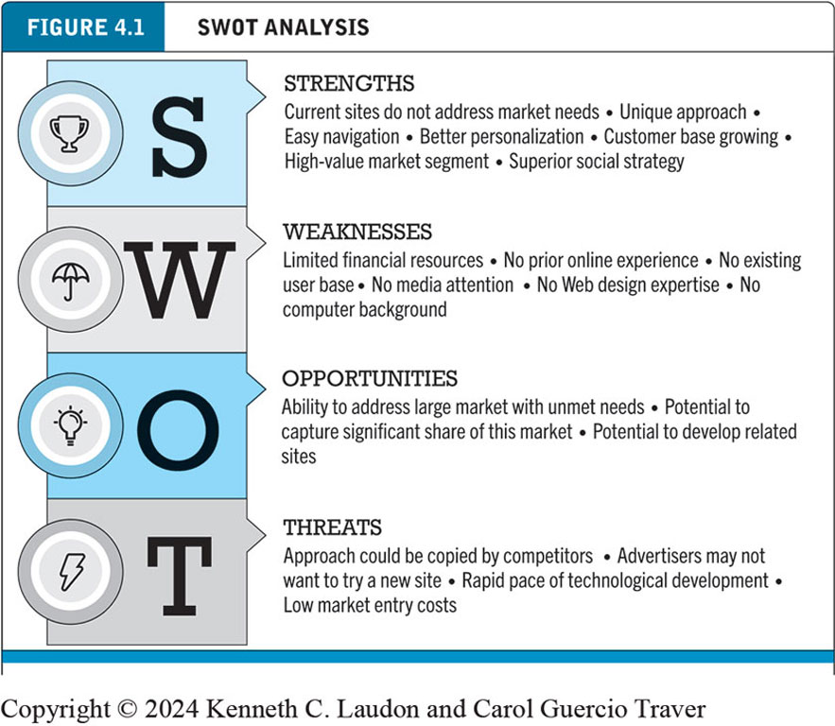
Figure 4.1 S W O T Analysis
Notes:
Figure 4.1, Page 183.
A SWOT analysis describes your firm’s strengths, weaknesses, opportunities, and threats.
Alt Text
Long description: SWOT stands for strengths, weaknesses, opportunities, and threats. Strengths: current sites do not address market needs, unique approach, easy navigation, better personalization, customer base growing, high value market segment, and superior social strategy. Weaknesses: limited financial resources, no prior online no existing user base, no media attention, no web design expertise, and no computer background. Opportunities: ability to address large market with unmet needs, potential to capture significant share of this market, potential to develop related sites. Threats: approach could be copied by competitors, advertisers may not want to try a new site, rapid pace of technological development, low market entry costs.

Slide 13
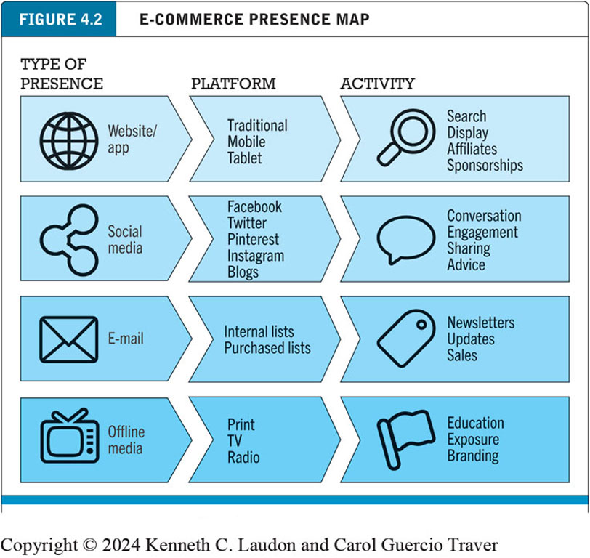
Figure 4.2 E-commerce Presence Map
Notes:
Figure 4.2, Page 184.
An e-commerce presence requires firms to consider the four different kinds of presence, and the platforms and activities associated with each type of presence.
Alt Text
Long description: The map depicts the different types of e-commerce presence, the platforms on which each is used and related activities for each. The row entries are as follows: Row 1: type of presence: website or app; platform: traditional, mobile, tablet; activity: search, display, affiliates, and sponsorships. Row 2: type of presence: social media; platform: Facebook, Twitter, Pinterest, Instagram, and blogs; activity: conversation, engagement, sharing, and advice. Row 3: type of presence: e-mail; platform: internal lists and purchased lists; activity: newsletters, updates, and sales. Row 4: type of presence: offline media; platform: print, T V, and radio; activity: education, exposure, and branding.

Slide 14
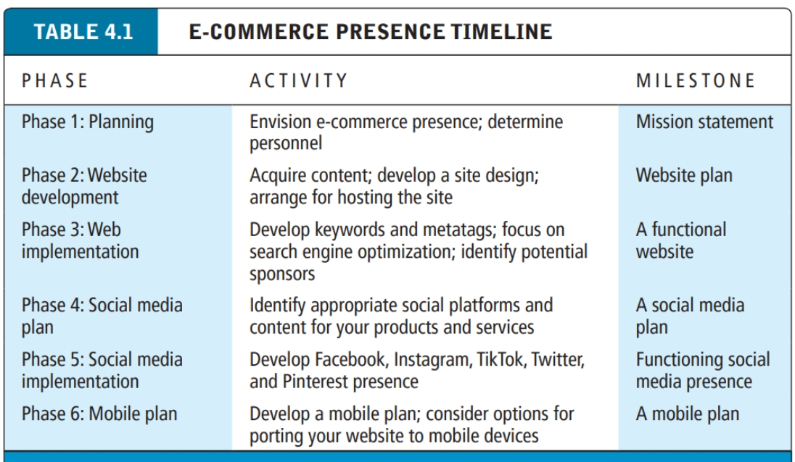

Slide 15
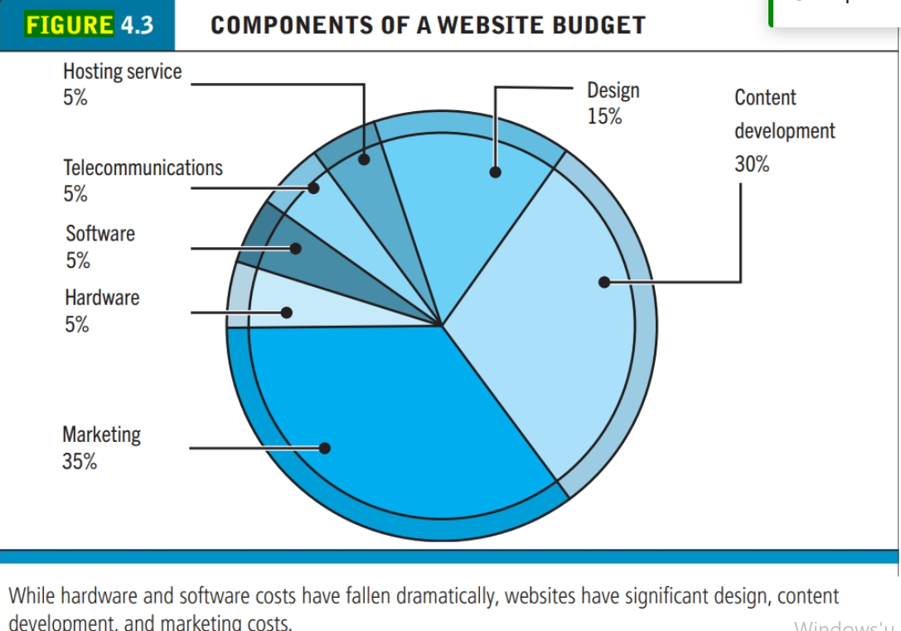

Slide 16
Building an E-commerce Site: A Systematic Approach
Most important management challenges:
Developing a clear understanding of business objectives
Knowing how to choose the right technology to achieve those objectives
Main factors to consider
Management: makes key decisions about business objectives and strategy, technology, design, and social and information poli-cies.
Hardware architecture
Software
Design: There are a number of different methodologies for building information systems such as websites. One of the most traditional methods is the systems development life cycle
Telecommunications
Human resources: bring together a team of individuals who possess the skill sets needed to build and man-age a successful e-commerce presence.

Slide 17
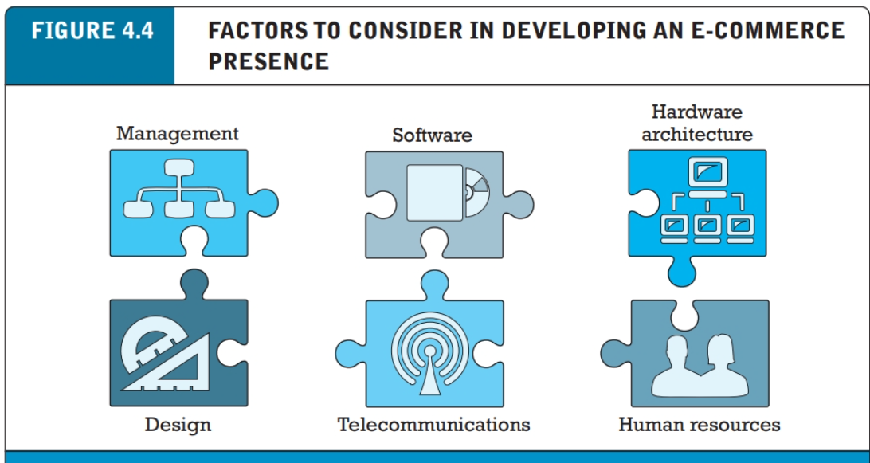

Slide 18
Planning: The Systems Development Life Cycle
Methodology for understanding business objectives of a system and designing an appropriate solution
Five major steps
Systems analysis/planning
Systems design
Building the system
Testing
Implementation

Slide 19
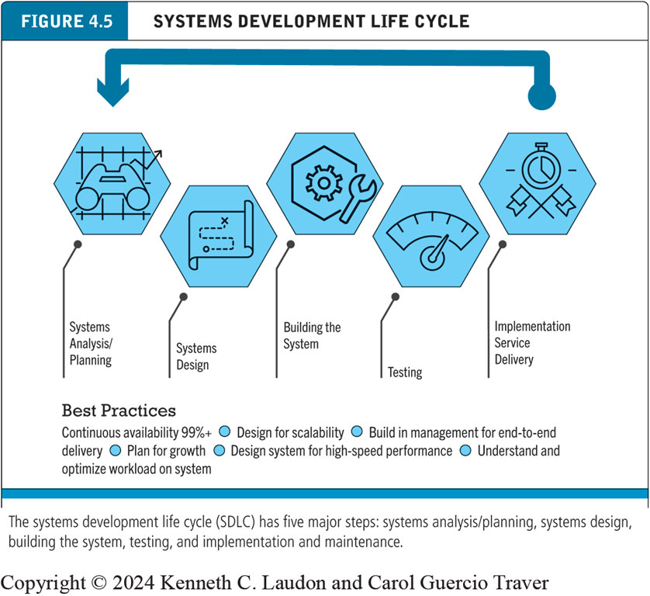
Figure 4.5 Systems Development Life Cycle
Notes:
Figure 4.5, Page 188.
The systems development life cycle (SDLC) has five major steps: systems analysis/planning, systems design, building the system, testing, and implementation and maintenance.
Alt Text
Long description: The steps in the flowchart are as follows: The systems development life cycle begins with systems analysis and planning, then systems design, then building the system, then testing, and then implementation service delivery. Best practices include continuous availability of 99 percent or more, design for scalability, build in management for end to end delivery, plan for growth, design system for high speed performance, and understand and optimize workload on system. The caption below the flow chart is as follows: The systems development life cycle or S D L C has five major steps: systems analysis slash planning, systems design, building the system, testing, and implementation and maintenance.

Slide 20
System Analysis/Planning
, “What do we want this website or app to do for our business?”
The key point is to let the business decisions drive the technology. This will ensure that your technology platform is aligned with your business. We will assume here that you have identified a business strategy and chosen a business model to achieve your strategic objectives But how do you translate your strategies, business models, and ideas into a working e-commerce website?
Create your Business objectives
List of capabilities you want your site to have
System functionalities
List of information system capabilities needed to achieve business objectives
Information requirements
Information elements that system must produce in order to achieve business objectives

Slide 21
Table 4.2 System Analysis, Business Objectives, System Functionalities, and Information Requirements for a Typical E-commerce Site (1 of 2)
Business Objective | System Functionality | Information Requirements
Display goods | Digital catalog | Dynamic text and graphics catalog
Provide product information | Product database | Product description, stocking numbers, inventory levels
Personalize/customize product | Customer on-site tracking | Site log for every customer visit; data mining capability to identify common customer paths and appropriate responses
Engage customers in conversations | On-site blog; user forums | Customer comments captured by software with blogging and community forum functionality
Execute a transaction | Shopping cart/payment system | Secure credit card clearing; multiple payment options
Accumulate customer information | Customer database | Name, address, phone, and e-mail for all customers; online customer registration

Slide 22
Table 4.2 System Analysis, Business Objectives, System Functionalities, and Information Requirements for a Typical E-commerce Site (2 of 2)
Business Objective | System Functionality | Information Requirements
Provide after-sale customer support | Sales database | Customer I D, product, date, payment, shipment date
Coordinate marketing/advertising | Ad server, e-mail server, e-mail, campaign manager, ad banner manager | Site behavior log of prospects and customers linked to e-mail and banner ad campaigns
Understand marketing effectiveness | Site tracking and reporting system | Number of unique visitors, pages visited, products purchased, identified by marketing campaign
Provide production and supplier links | Inventory management system | Product and inventory levels, supplier I D and contact, order quantity data by product

Slide 23
Systems Design: Hardware and Software Platforms
Once you have identified the business objectives and system functionalities and have developed a list of precise information requirements, you can begin to consider just how all this functionality will be delivered.
You must come up with a system design specification—a description of the main components in the system and their relationship to one another. The system design itself can be broken down into two components: a logical design and a physical design.

Slide 24
Systems Design: Hardware and Software Platforms
System design specification
Description of main components of a system and their relationship to one another
Two components of system design:
Logical design
Data flow diagrams, processing functions, databases: a data flow diagram that describes the flow of information at your e-commerce site
Physical design
Specifies actual physical, software components, models, and so on. Details the specific model of server to be purchased, the software to be used, the size of the telecommunications link that will be required, the way the system will be backed up and protected from outsiders, and so on

Slide 25
Building the System: In-House Versus Outsourcing
Outsourcing: Hiring vendors to provide services involved in building site
Build own versus outsourcing
Build your own web site requires team with diverse skill set; choice of software tools; both risks and possible benefits
Host own versus outsourcing
Hosting: Hosting company responsible for ensuring site is accessible 24/7, for monthly fee
Co-location: Firm purchases or leases web server (with control over its operation), but server is located at vendor’s facility

Slide 26
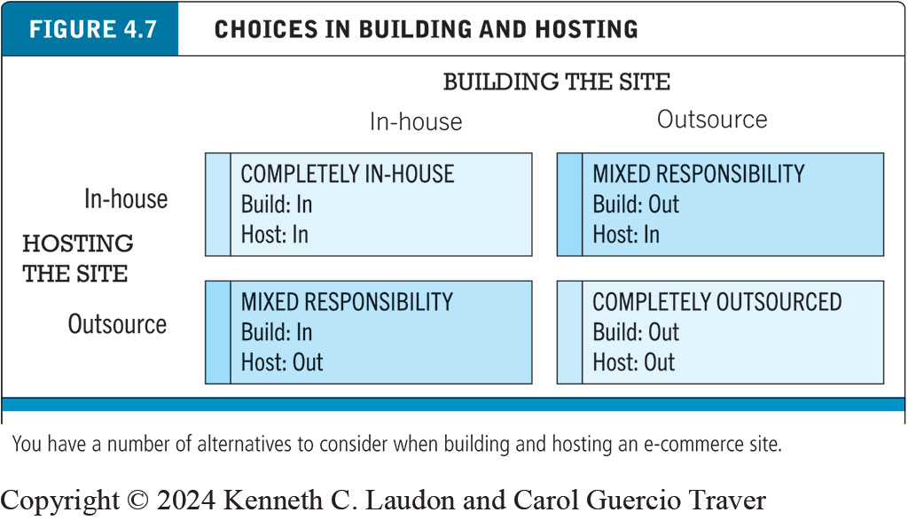
Figure 4.7 Choices in Building and Hosting
Notes:
Figure 4.7, Page 192.
You have a number of alternatives to consider when building and hosting an e-commerce site.
Alt Text
Long description: The matrix has four squares as follows: At the intersection of hosting the site in-house and building the site in-house, there is a square with the following label: completely in-house: build: in and host: in. At the intersection of hosting the site in house, building the site outsource, there is a square with the following label: mixed responsibility: build: out and host: in. At the intersection of hosting the site outsource, building the site in house, there is a square with the following label: mixed responsibility: build: in and host: out. At the intersection of hosting the site outsource and building the site outsource, there is a square with the following label: completely in-house: build: out and host: out.

Slide 27
Insight on Business: Wix Makes Creating Websites Easy
Class Discussion
What value does Wix offer to small businesses?
Are there any drawbacks to using Wix to create an e-commerce presence?
How are service providers like Wix changing the nature of e-commerce?

Slide 28
Companies, such as WordPress, Wix, Squarespace, Shopify, Square, and Weebly, provide inexpensive and easy-to-use website-building tools. All of these companies also provide access to built-in e-commerce functionality. However, if you do so, you will be limited to the “look and feel” and functionality provided by the templates and infrastructure supplied by these vendors. If you want more customization than a pre-built template can provide and have some programming experience, you can build the website yourself. Here, too, there are a variety of options. You can choose to build the site truly “from scratch,” using HTML/ HTML5 and CSS (see Chapter 3) and adding interactivity with JavaScript and other pro-gramming tools (see Section 4.5). You can also use web development tools such as Adobe Dreamweaver CC and Microsoft Visual Studio, which enable developers to quickly create websites.

Slide 29
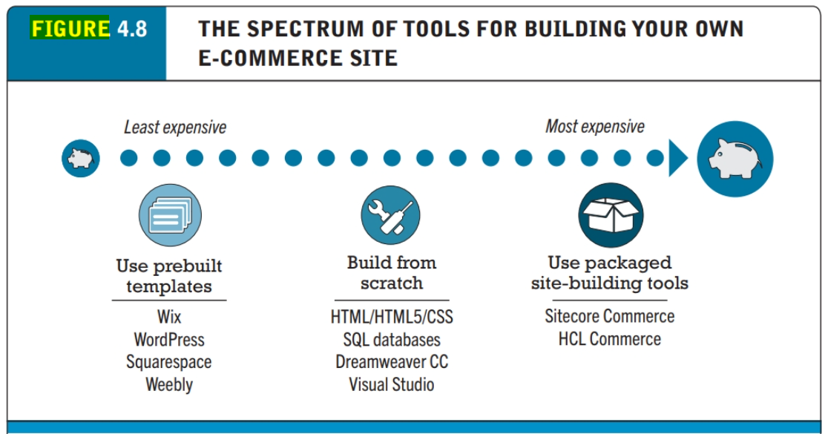

Slide 30
Testing the System
Testing: Once the system has been built and programmed, you will have to engage in a testing process. Testing is required whether the system is outsourced or built in-house. A complex e-commerce site can have thousands of pathways through the site, each of which must be documented and then tested. It is important to note that testing is generally under-budgeted. As much as 50% of the budget can be consumed by testing and rebuilding
Unit testing
System testing
Acceptance testing
A/B testing (split testing)
Multivariate testing

Slide 31
Implementation, Maintenance, and Optimization
Systems break down unpredictably
Maintenance is ongoing
Maintenance costs: Similar to development costs
A $40,000 e-commerce site may require $40,000 annually to upkeep
Why does it cost so much to maintain an e-commerce site? E-commerce sites are always in a process of change, improvement, and correction. Studies of traditional systems maintenance have found 20% of the time is devoted to debugging code and responding to emergency situations. Another 20% of the time is concerned with changes in reports, data files, and links to backend databases. The remaining 60% of maintenance time is devoted to general administration (making product and price changes in the catalog) and making changes and enhancements to the system.
Benchmarking

Slide 32
The long-term success of an e-commerce site for a medium-sized to large business typically depends on a dedicated team of employees (the web team) whose sole job is to monitor and adapt the site to changing market conditions.
The web team must be multi-skilled; it will typically include programmers, designers, and business manag-ers drawn from marketing, production, and sales support.
One of the first tasks of the web team is to listen to customers’ feedback on the site and respond to that feedback as necessary.
A second task is to develop a systematic monitoring and testing plan to be followed weekly to ensure all the links are operating, prices are correct, and pages are updated.
Other important tasks of the web team include benchmarking (a process in which the site is compared with those of competitors in terms of response speed, quality of layout, and design) and keeping the site current on pricing and promotions. The Web is a competitive environment where you can very rapidly frustrate and lose customers with a dysfunctional site.

Slide 33
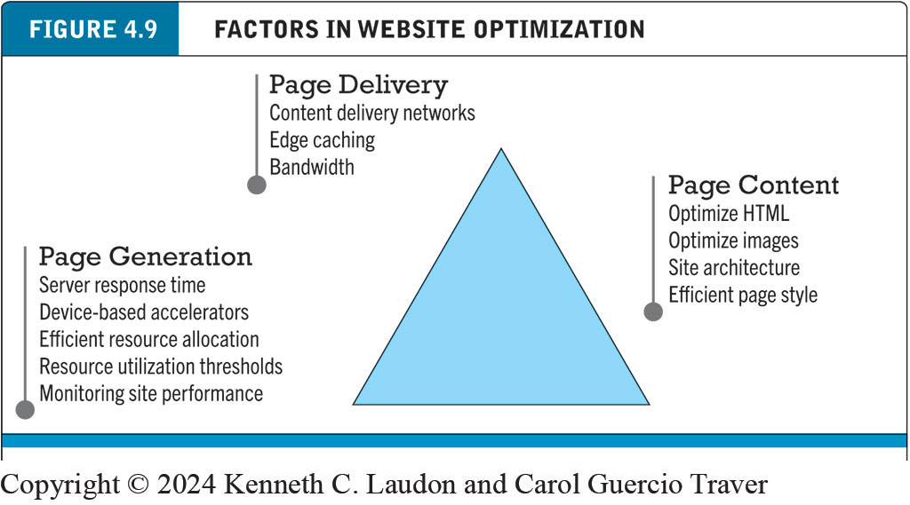
Figure 4.9 Factors in Website Optimization
Notes:
Figure 4.9, Page 198.
Website optimization requires that you consider three factors: page content, page generation, and page delivery.
Alt Text
Long description: Page generation factors are server response time, device-based accelerators, efficient resource allocation, resource utilization thresholds, monitoring site performance. Page delivery factors are content delivery networks, edge caching, and bandwidth. Page content factors are optimize H T M L, optimize images, site architecture, and efficient page style.

Slide 34
Factors in Website Optimization
If you are a manager or marketing executive, you will want the website operating in a way that fulfills customers’ expectations. You’ll have to make sure the website is optimized to achieve this business objective. The optimization of website performance involves a number of factors, including page content, page generation, and page delivery.
Using efficient styles and techniques for page content can reduce response times by two to five seconds. Simple steps include reducing unnecessary HTML comments and white space, using more efficient graphics, and avoiding unnecessary links to other pages in the site. Page generation speed can be enhanced by segregating computer servers to perform dedicated functions. Page delivery can be sped up by using specialized content delivery networks such as Akamai or by increasing local bandwidth.

Slide 35
E-commerce Merchant Server Software (E-commerce Software Platforms) (1 of 3)
Provides basic functionality for sales
Online catalog
List of products available on website
Shopping cart
Allows shoppers to set aside, review, edit selections, and then make purchase
Credit card processing
Typically works in conjunction with shopping cart
Verifies card and puts through credit to company’s account at checkout

Slide 36
E-commerce Merchant Server Software (E-commerce Software Platforms) (2 of 3)
Different options for different-sized businesses
Small and medium-sized businesses: Shopify; WordPress (WooCommerce), Wix, Square, Weebly, Squarespace, Bigcommerce, open-source solutions
Mid-range: H C L Commerce; Sitecore Experience Commerce
High-end: S A P Commerce, Oracle A T G Web Commerce, Adobe Commerce
Many now also available as cloud-based SaaS solutions.

Slide 37
E-commerce Merchant Server Software (E-commerce Software Platforms) (3 of 3)
Key factors in selecting a package
Functionality
Support for different business models, including m-commerce
Business process modeling tools
Visual site management and reporting
Performance and scalability
Connectivity to existing business systems
Compliance with standards
Global and multicultural capability
Local sales tax and shipping rules

Slide 38
E-commerce Website Features That Annoy Customers (1 of 2)
Requiring user to view ad or intro page before going to website content
Pop-up and pop-under ads and windows
Too many clicks to get to the content
Links that don’t work
Confusing navigation; no search function
Requirement to register and log in before viewing content or ordering
Slow loading pages
Content that is out of date

Slide 39
E-commerce Website Features That Annoy Customers (2 of 2)
Inability to use browser’s Back button
No contact information available (web form only)
Unnecessary splash/flash screens, animation, etc.
Music or other audio that plays automatically
Unprofessional design elements
Text not easily legible due to size, color, format
Typographical errors
No or unclear returns policy

Slide 40
Table 4.9 The Eight Most Important Factors in Successful E-commerce Site Design
Factor | Description
Functionality | Pages that work, load quickly, and point the customer toward your product offerings
Informational | Links that customers can easily find to discover more about you and your products
Ease of use | Simple foolproof navigation
Redundant navigation | Alternative navigation to the same content
Ease of purchase | One or two clicks to purchase
Multi-browser functionality | Site works with the most popular browsers
Simple graphics | Avoids distracting, obnoxious graphics and sounds that the user cannot control
Legible text | Avoids backgrounds that distort text or make it illegible

Slide 41
Insight on Society: Designing for Accessibility
Class Discussion
Why might some merchants be reluctant to make their websites accessible to users with disabilities?
How can websites be made more accessible?
Should all websites be required by law to provide “equivalent alternatives” for visual and sound content?
What additional accessibility problems do mobile devices pose?

Slide 42
Developing a Mobile Website and Building Mobile Applications
Types of m-commerce platforms
Mobile website
Native app
Mobile web app
Hybrid app
Runs inside native container
App distribution
Based on H T M L5, C S S, JavaScript

Slide 43
Planning and Building a Mobile Presence
Identify business objectives, system functionality, and information requirements
Choices
Mobile website or mobile web app
Less expensive
Native app
Can use device hardware, available offline

Slide 44
Table 4.13 Unique Features That Must Be Taken Into Account When Designing a Mobile Presence
Feature | Implications For Mobile Platform
Hardware | Mobile hardware is smaller, and there are more resource constraints in data storage and processing power.
Connectivity | The mobile platform is constrained by slower connection speeds than desktop websites.
Displays | Mobile displays are much smaller and require simplification. Some screens are not good in sunlight.
Interface | Touch-screen technology introduces new interaction routines different from the traditional mouse and keyboard. The mobile platform is not a good data entry tool but can be a good navigational tool.

Slide 45
Mobile Presence Design Considerations
Platform constraints
Graphics, file sizes
Mobile first design
Desktop website design after mobile design
Responsive web design (R W D)
C S S site adjusts layout of site according to device screen resolutions
Adaptive web design (A W D)
Server delivers different templates or versions of site optimized for device

Slide 46
Cross-Platform Mobile App Development Tools
Objective C, Java
Low cost, open-source alternatives
Flutter
React Native
Appery.io
Codiqa
Swiftic
PhoneGap
Axway Appcelerator

Slide 47
Mobile Presence: Performance and Cost Considerations
Mobile first design
Most efficient
Mobile website
Resizing existing website for mobile access is least expensive
Mobile web app
Can utilize browser A P I
Native app
Most expensive; requires more programming

Slide 48

Copyright
This work is protected by United States copyright laws and is provided solely for the use of instructors in teaching their courses and assessing student learning. Dissemination or sale of any part of this work (including on the World Wide Web) will destroy the integrity of the work and is not permitted. The work and materials from it should never be made available to students except by instructors using the accompanying text in their classes. All recipients of this work are expected to abide by these restrictions and to honor the intended pedagogical purposes and the needs of other instructors who rely on these materials.

